Slide 1
IDT INTERIM PRESENTATION SURFACE PROFILOMETER TEAM MEMBERS: NICOLE MURRAY, NIALL LINNANE, MARK ROE

Slide 2
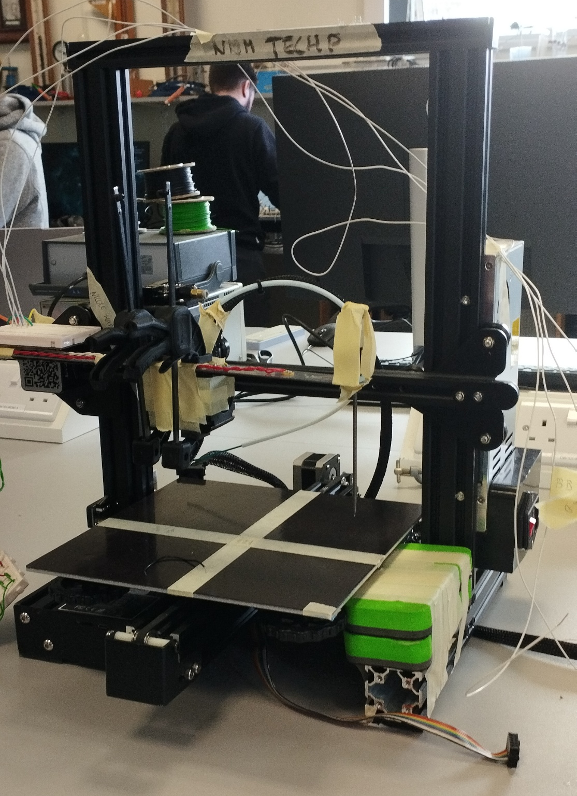
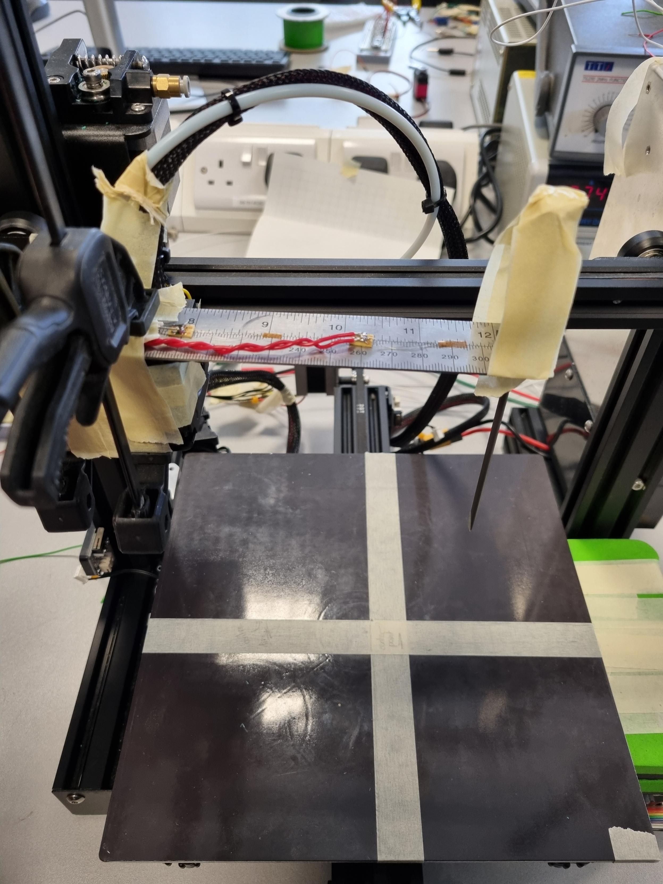
SURFACE PROFILOMETER

Slide 3
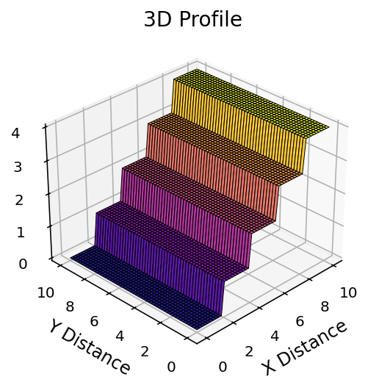
Purpose

Slide 4
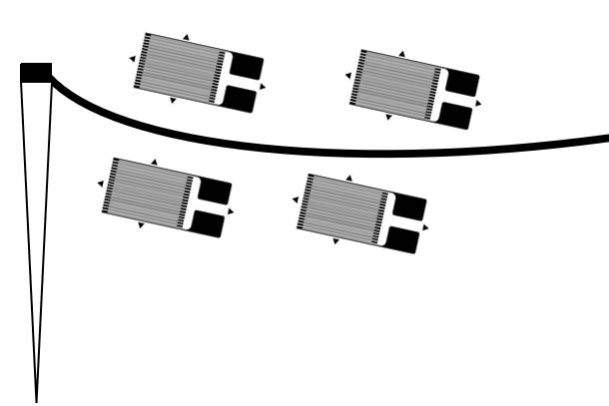
Method
$$.^{[1]}$$

Slide 5
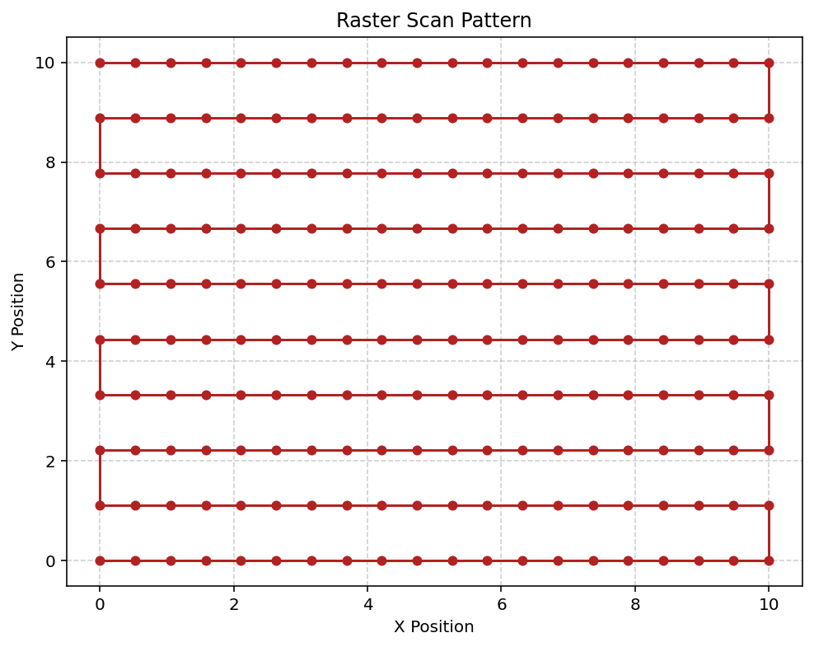
METHOD

Slide 6
Current Progress

Slide 7
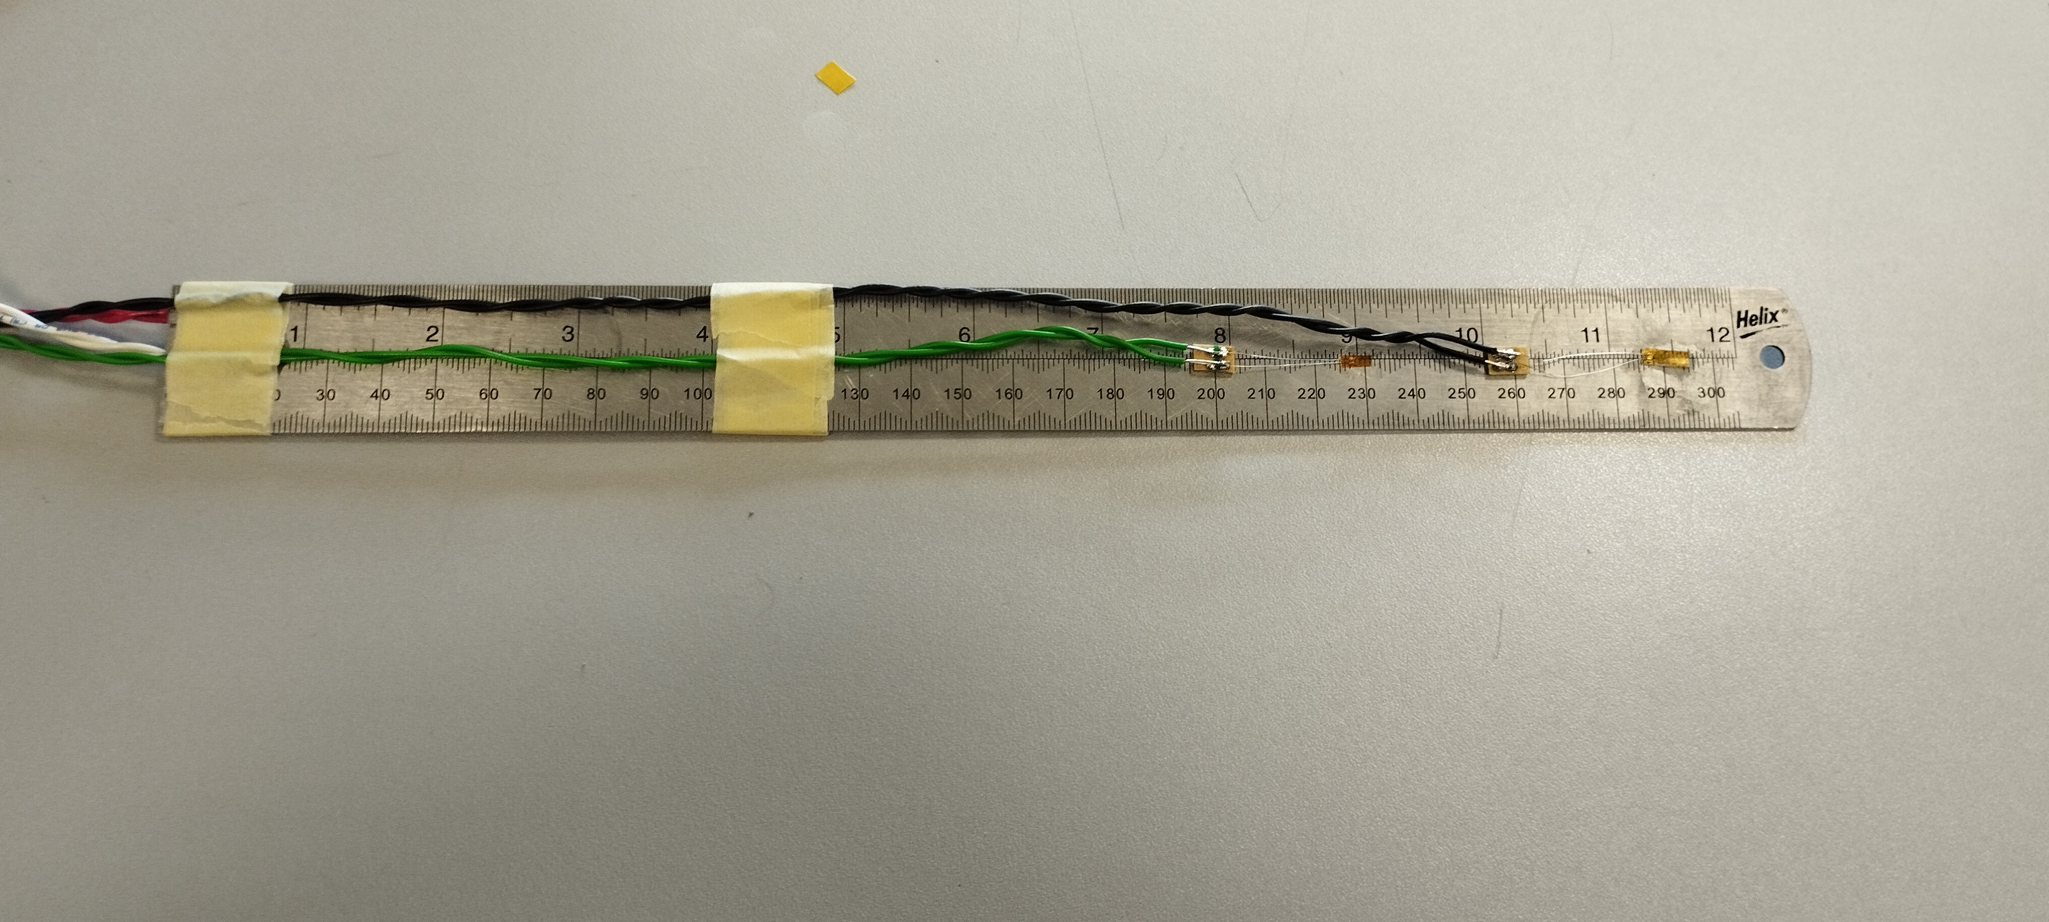
Cantilever & Strain Gauges
Figure (7) – Actual Cantilever

Slide 8
Calibration

Slide 9
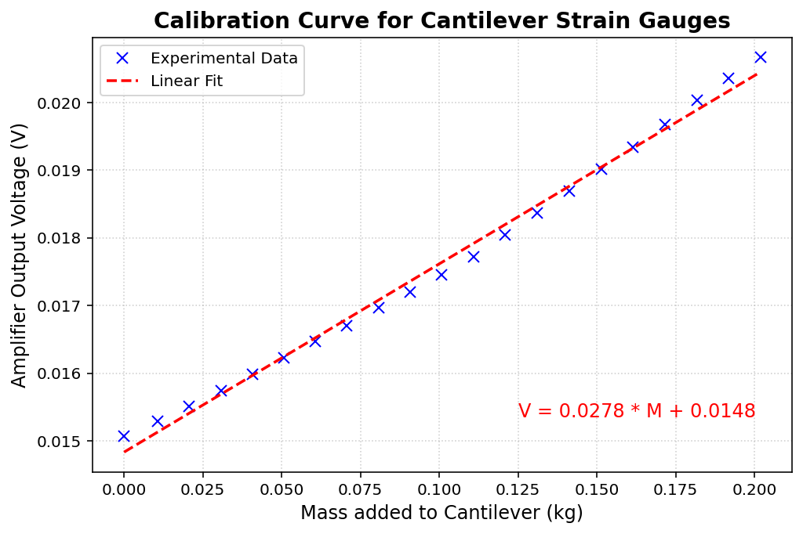
Calibration

Slide 10
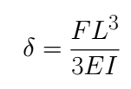
Deflection Calculation

Slide 11
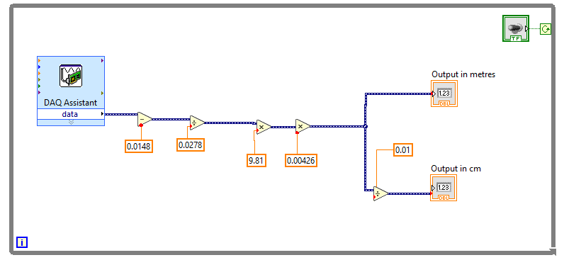
LabView Code

Slide 12
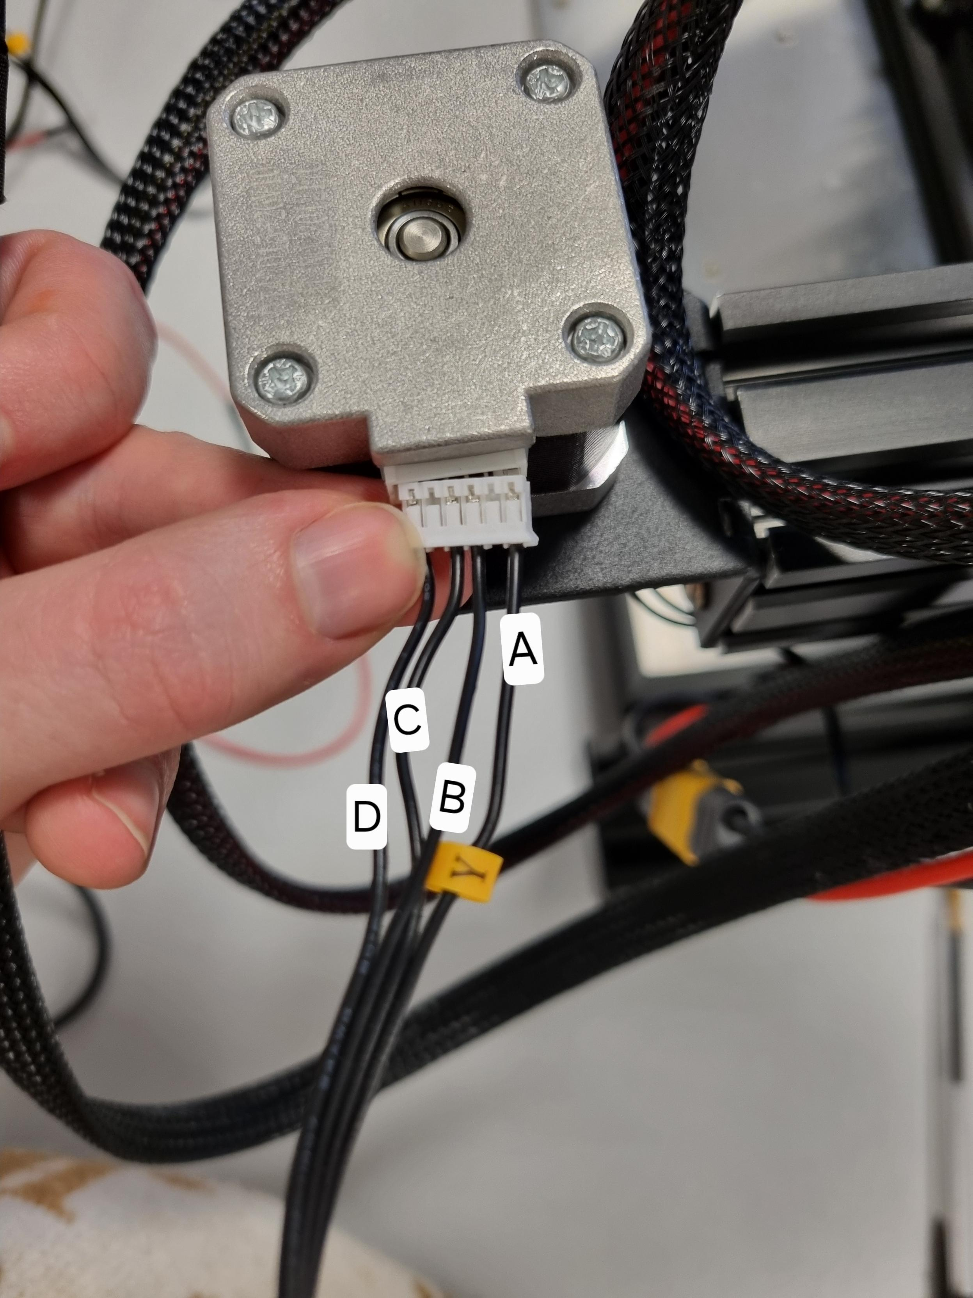
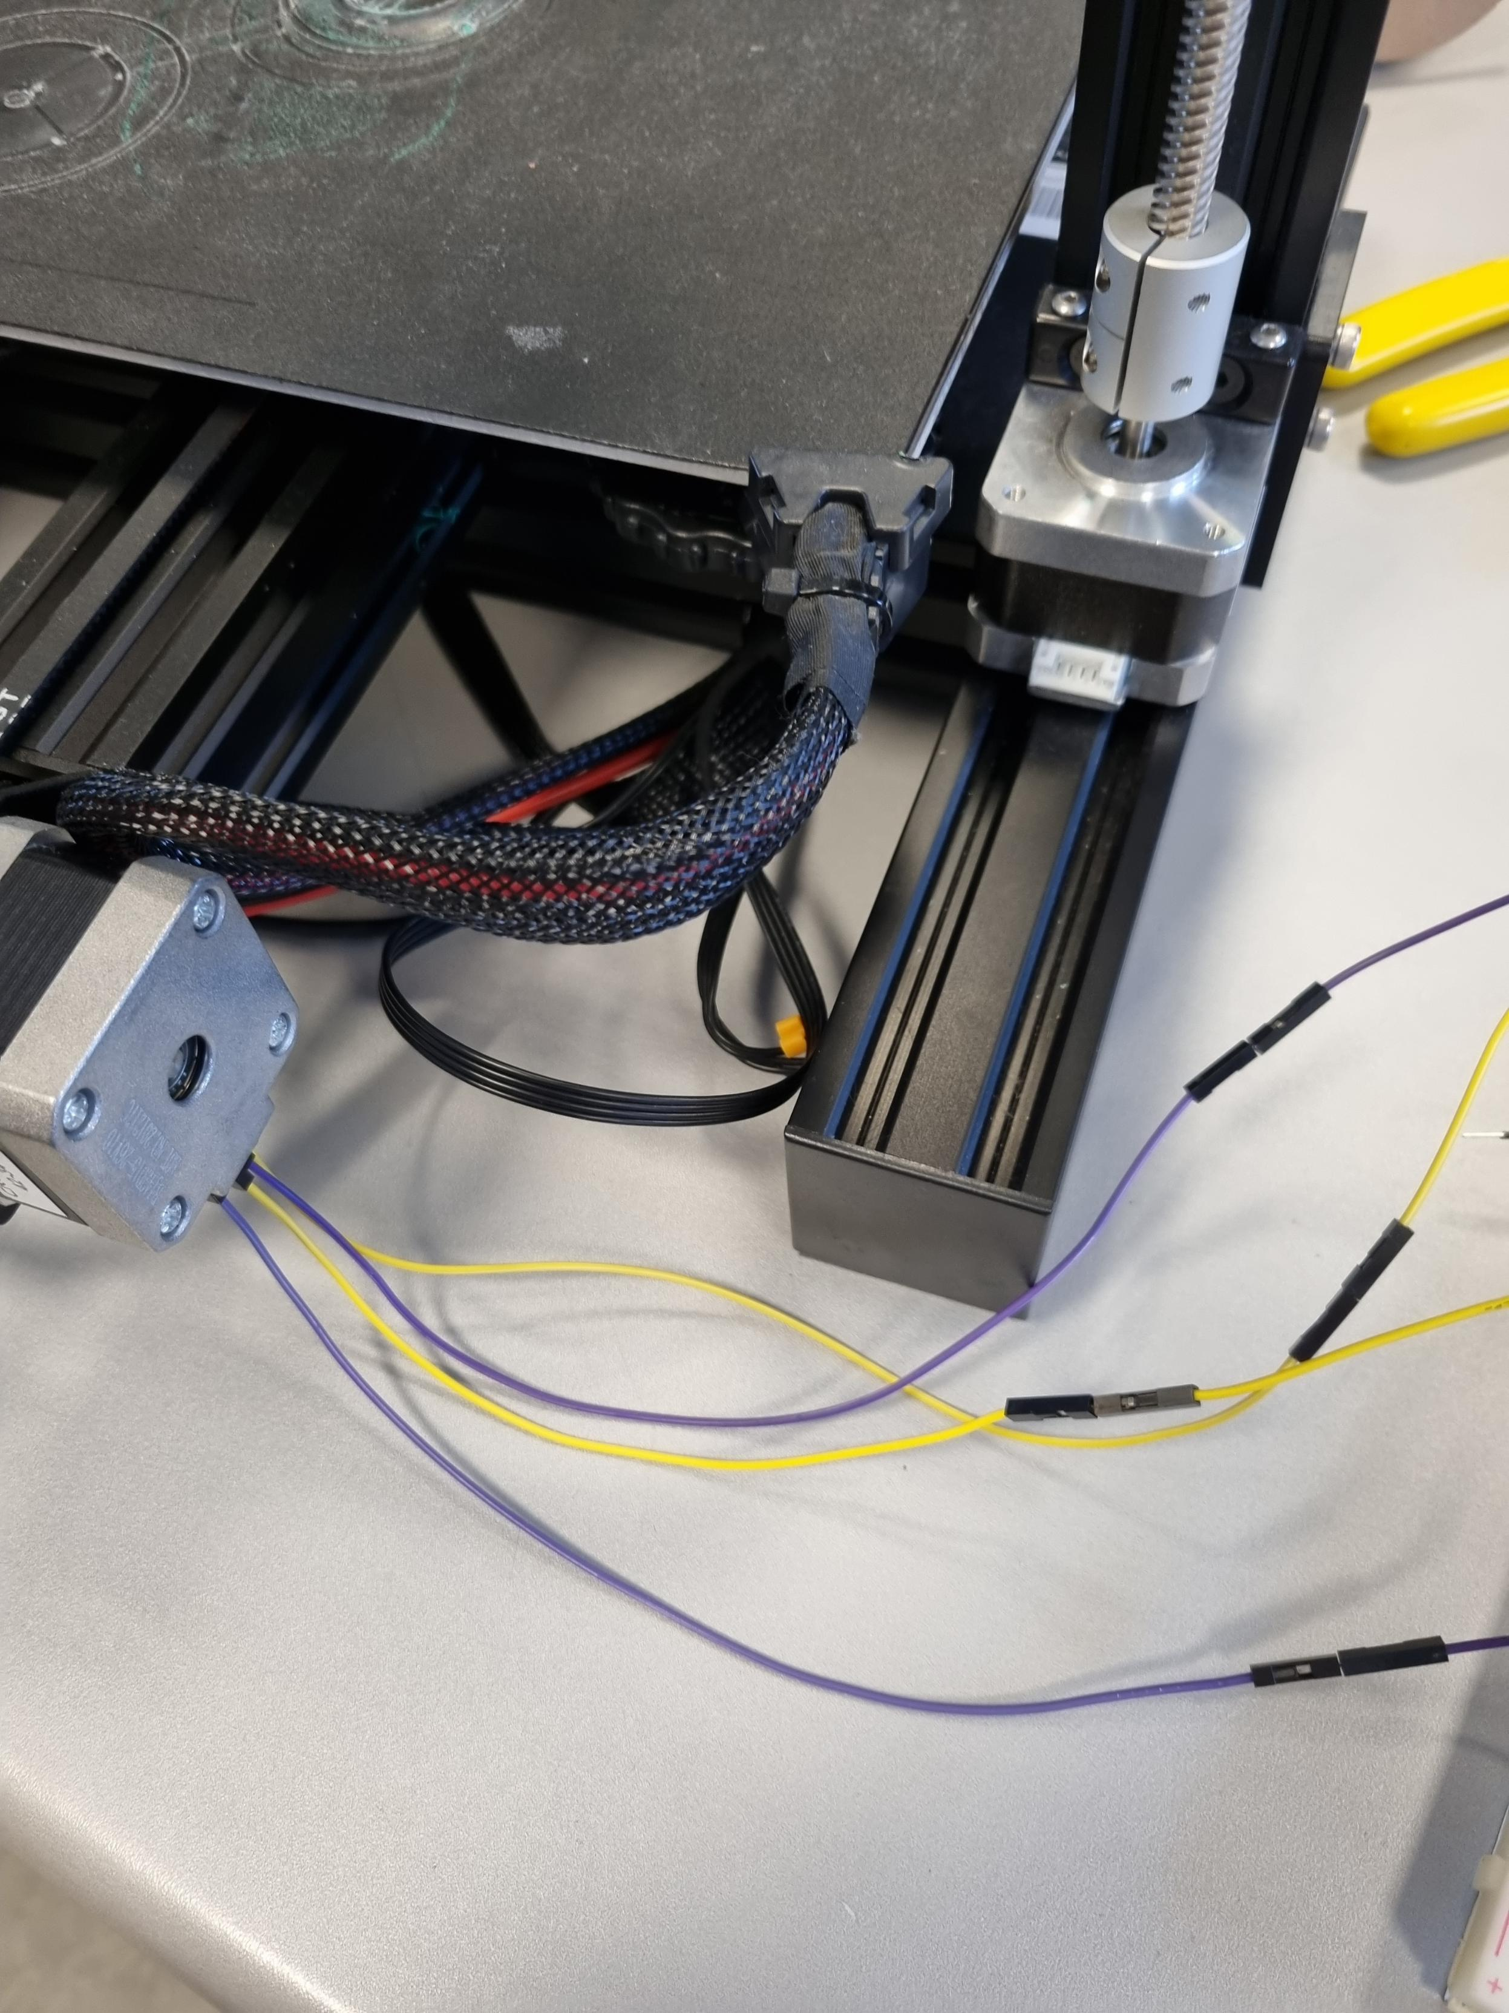
The Stepper Motors
Nema-17 stepper motor wiring diagram [2]

Slide 13
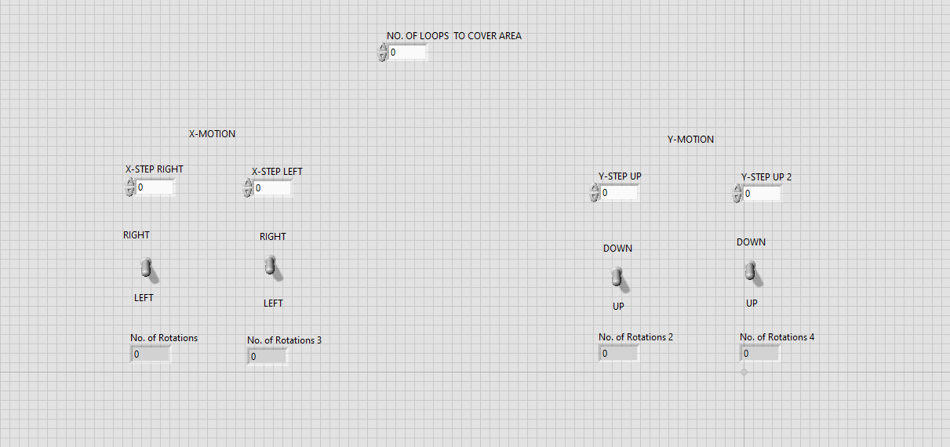
LabView Code
Stepper motor code built from lab 8 code [7]

Slide 14
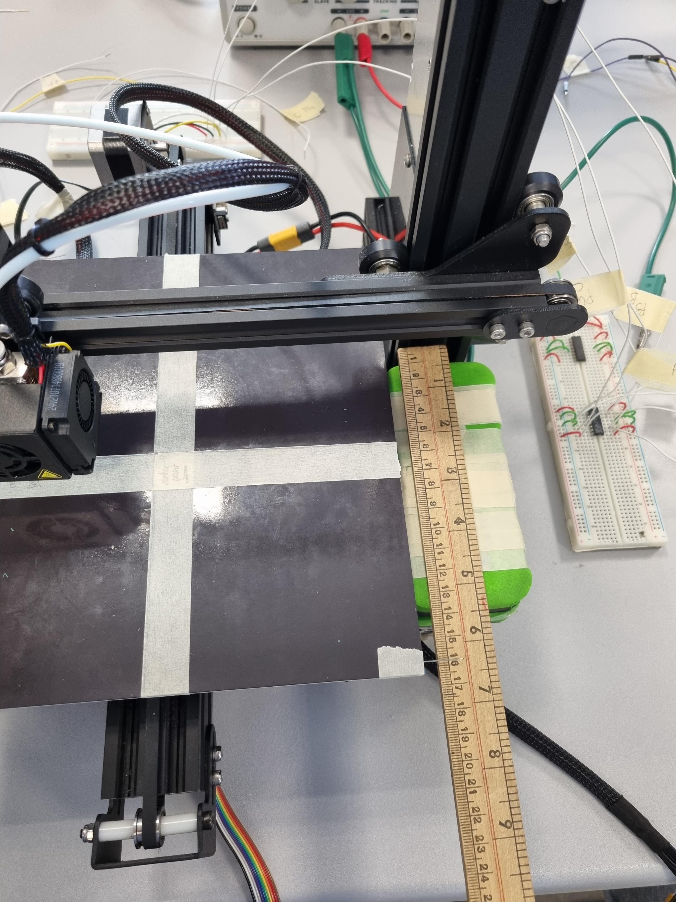
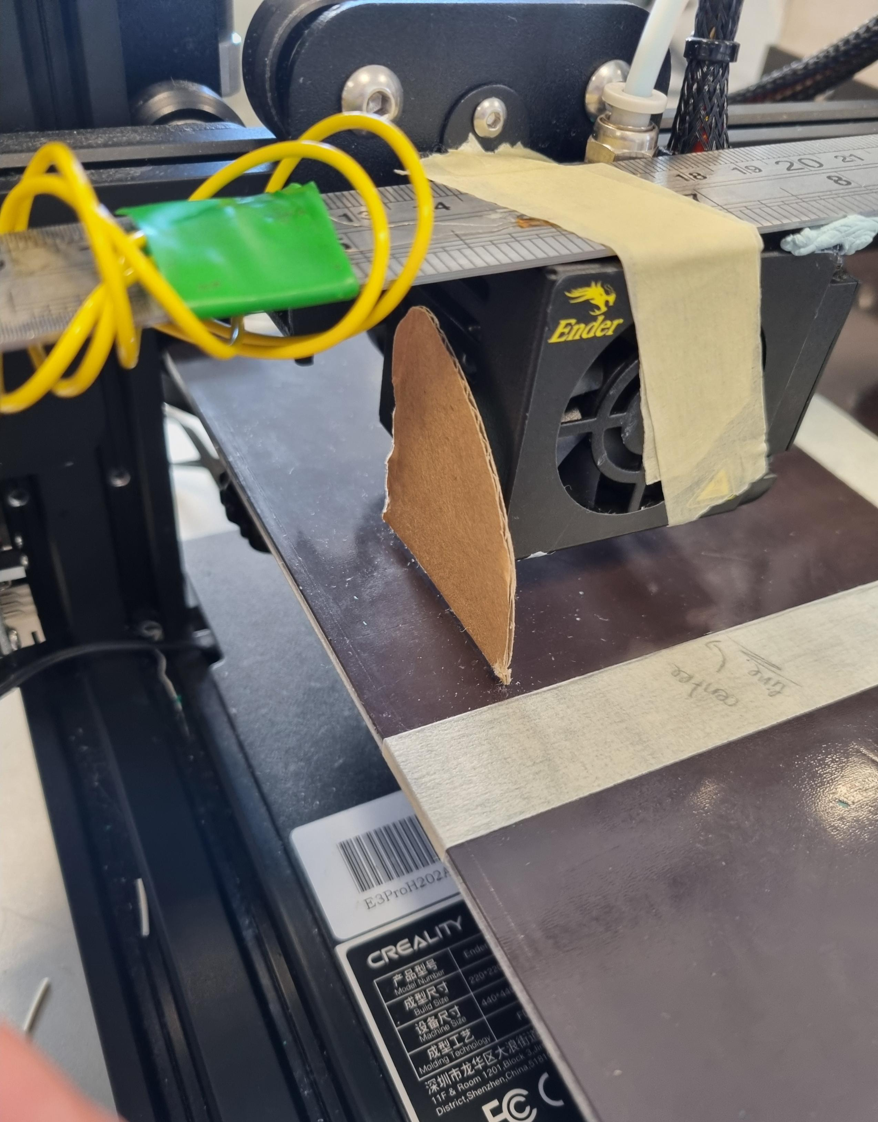
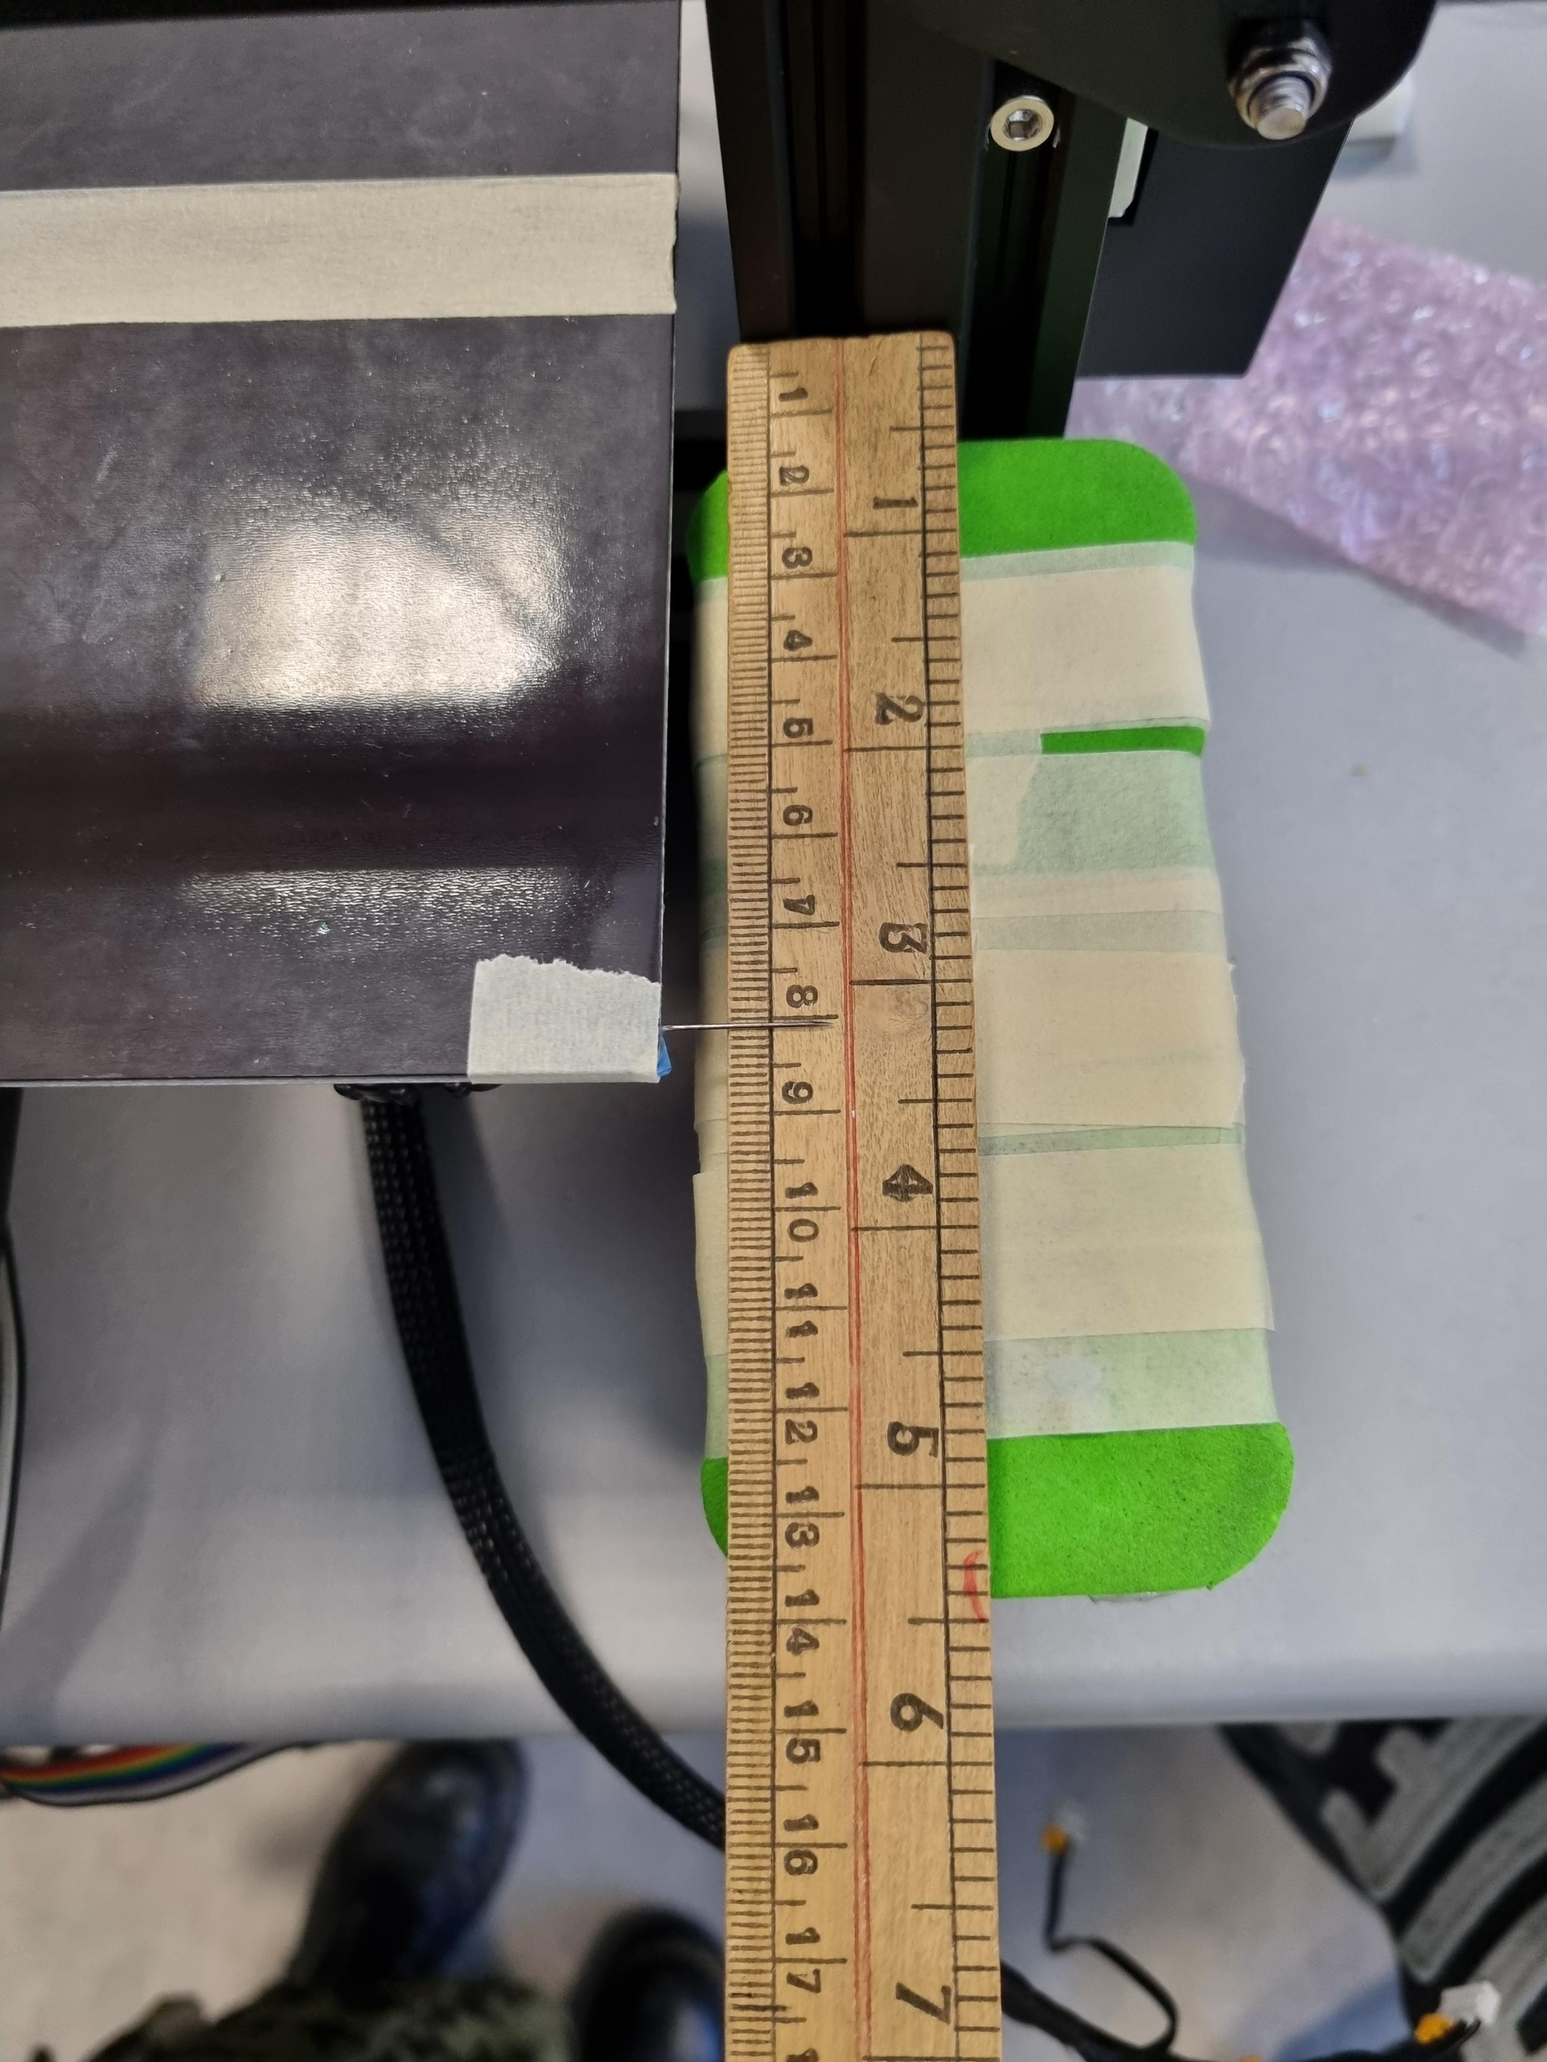
Calibration

Slide 15
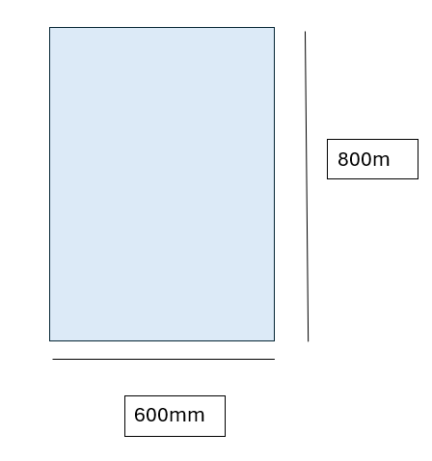
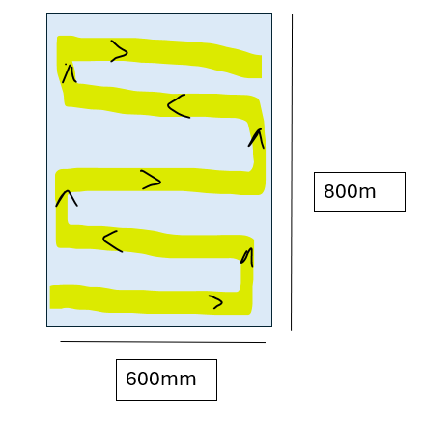
Calibration Equation
xmm ÷ 0.2 = step
0.2mm/step

Slide 16
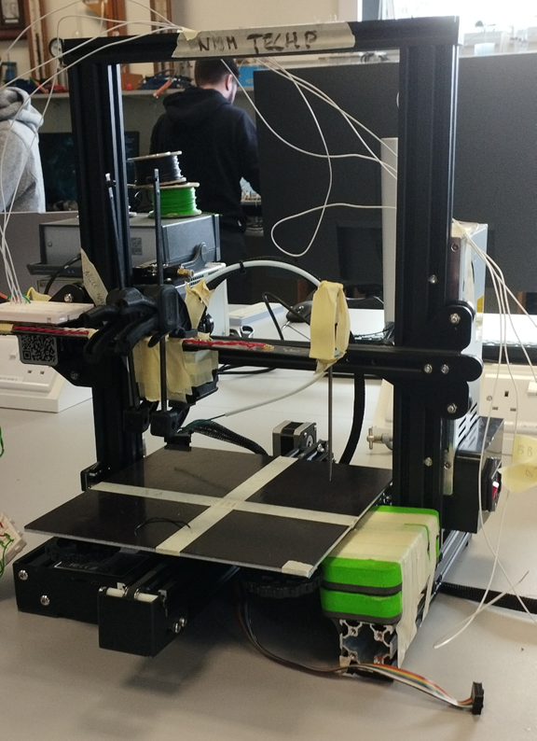
Z-Axis Control
NEMA 17 stepper motor
L293D Driver chip
1.8 degrees per step = .04mm/step linear motion

Slide 17
Z-Axis Control
Laser reflection system
Stops z-axis motor
Seen here is the laser centred on the photodiode

Slide 18
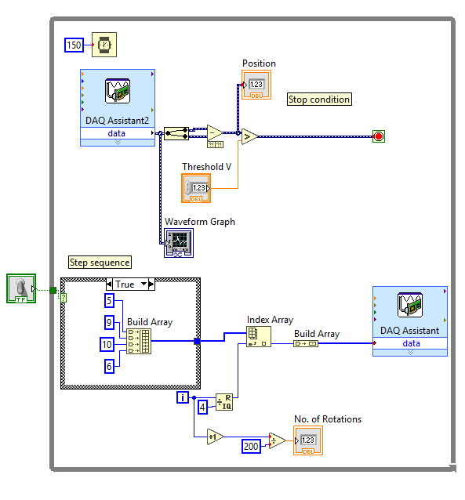
Laser Reflection System
Photodiode Voltage is compared with Threshold voltage
If stop condition is met the loop condition is set to stop
Raster scanning can now commence

Slide 19
Current Timeline

Slide 21
THANK YOU FOR LISTENING

Slide 22
References
[1]Oxford Instruments: https://raman.oxinst.com/techniques/scanning-probe-microscopy
[2]Nema-17 stepper motor data sheet, SIMAC Electronics GmbH:
https://joy-it.net/files/files/Produkte/NEMA17-06/NEMA17-06_Datasheet.pdf
[3]Creality,Ender-3 printer:
https://www.creality3dofficial.eu/products/creality-ender-3-3d-printer?gad_source=1&gclid=Cj0KCQiAwtu9BhC8ARIsAI9JHanTq4RzDzUEHRzluuD1g7rLxMAnzTBQp7xI-lUwHGvFyjiFxP5Dam8aApReEALw_wcB
[4] L293D driver chip, Texas Instruments:
https://www.ti.com/lit/ds/symlink/l293.pdf
[5]Texas Instruments, INA122 Data Sheet:
https://www.ti.com/lit/ds/symlink/ina122.pdf?ts=1740051633788&ref_url=https%253A%252F%252Fwww.google.com%252F

Slide 23
References
[6]Radionics, RS PRO Data Sheet:
https://docs.rs-online.com/7b45/A700000008880707.pdf
[7]Lab 8 stepper motor code, Brian Ashall:
https://vlegalwaymayo.atu.ie/mod/resource/view.php?id=1115347

Slide 24
Appendix

Slide 25
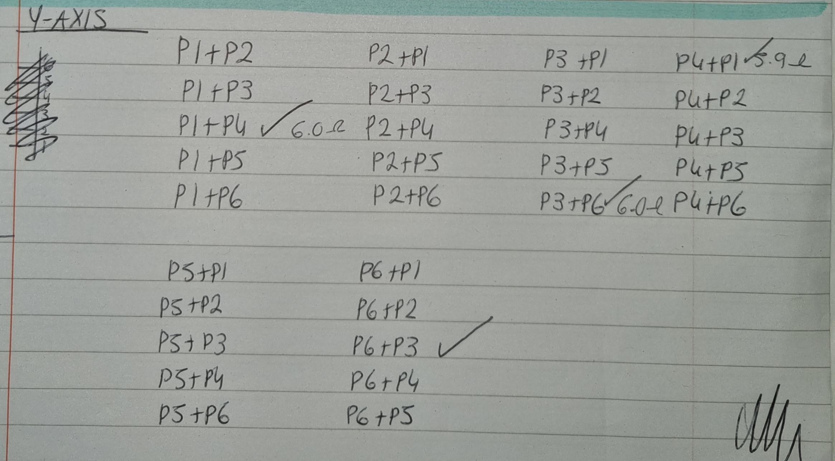
Stepper Motor Coils
The pin to coil connection

Slide 26
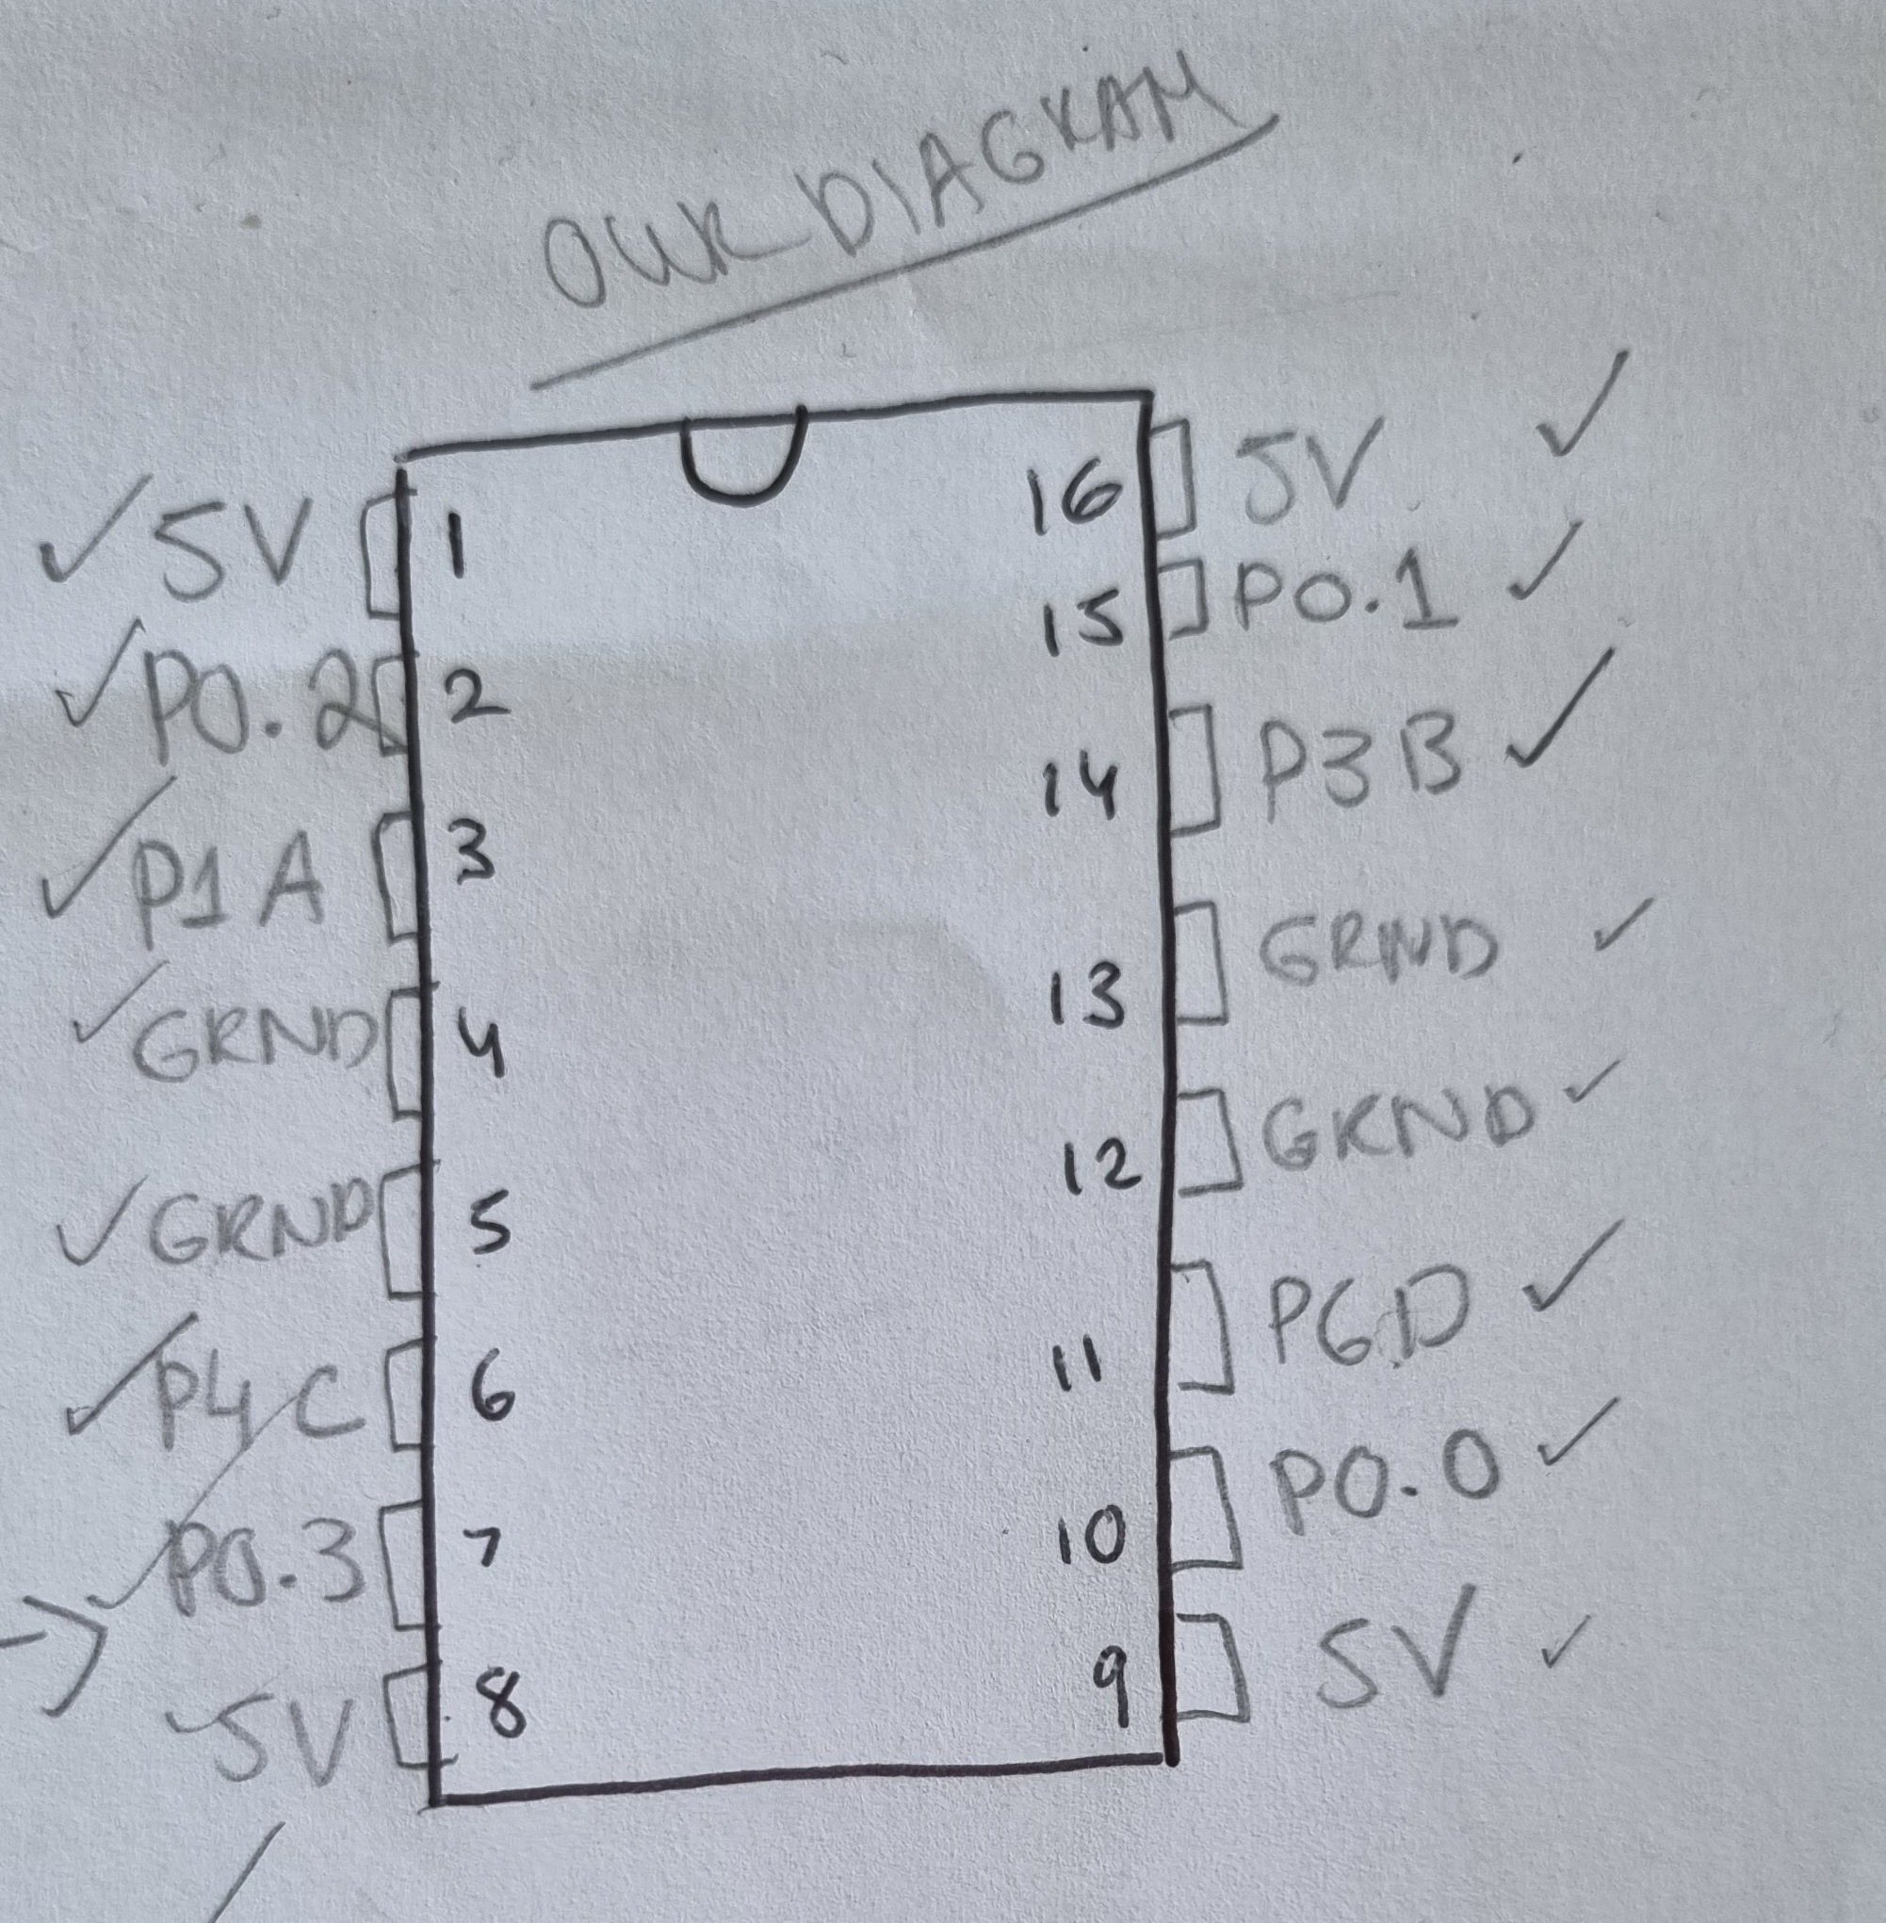
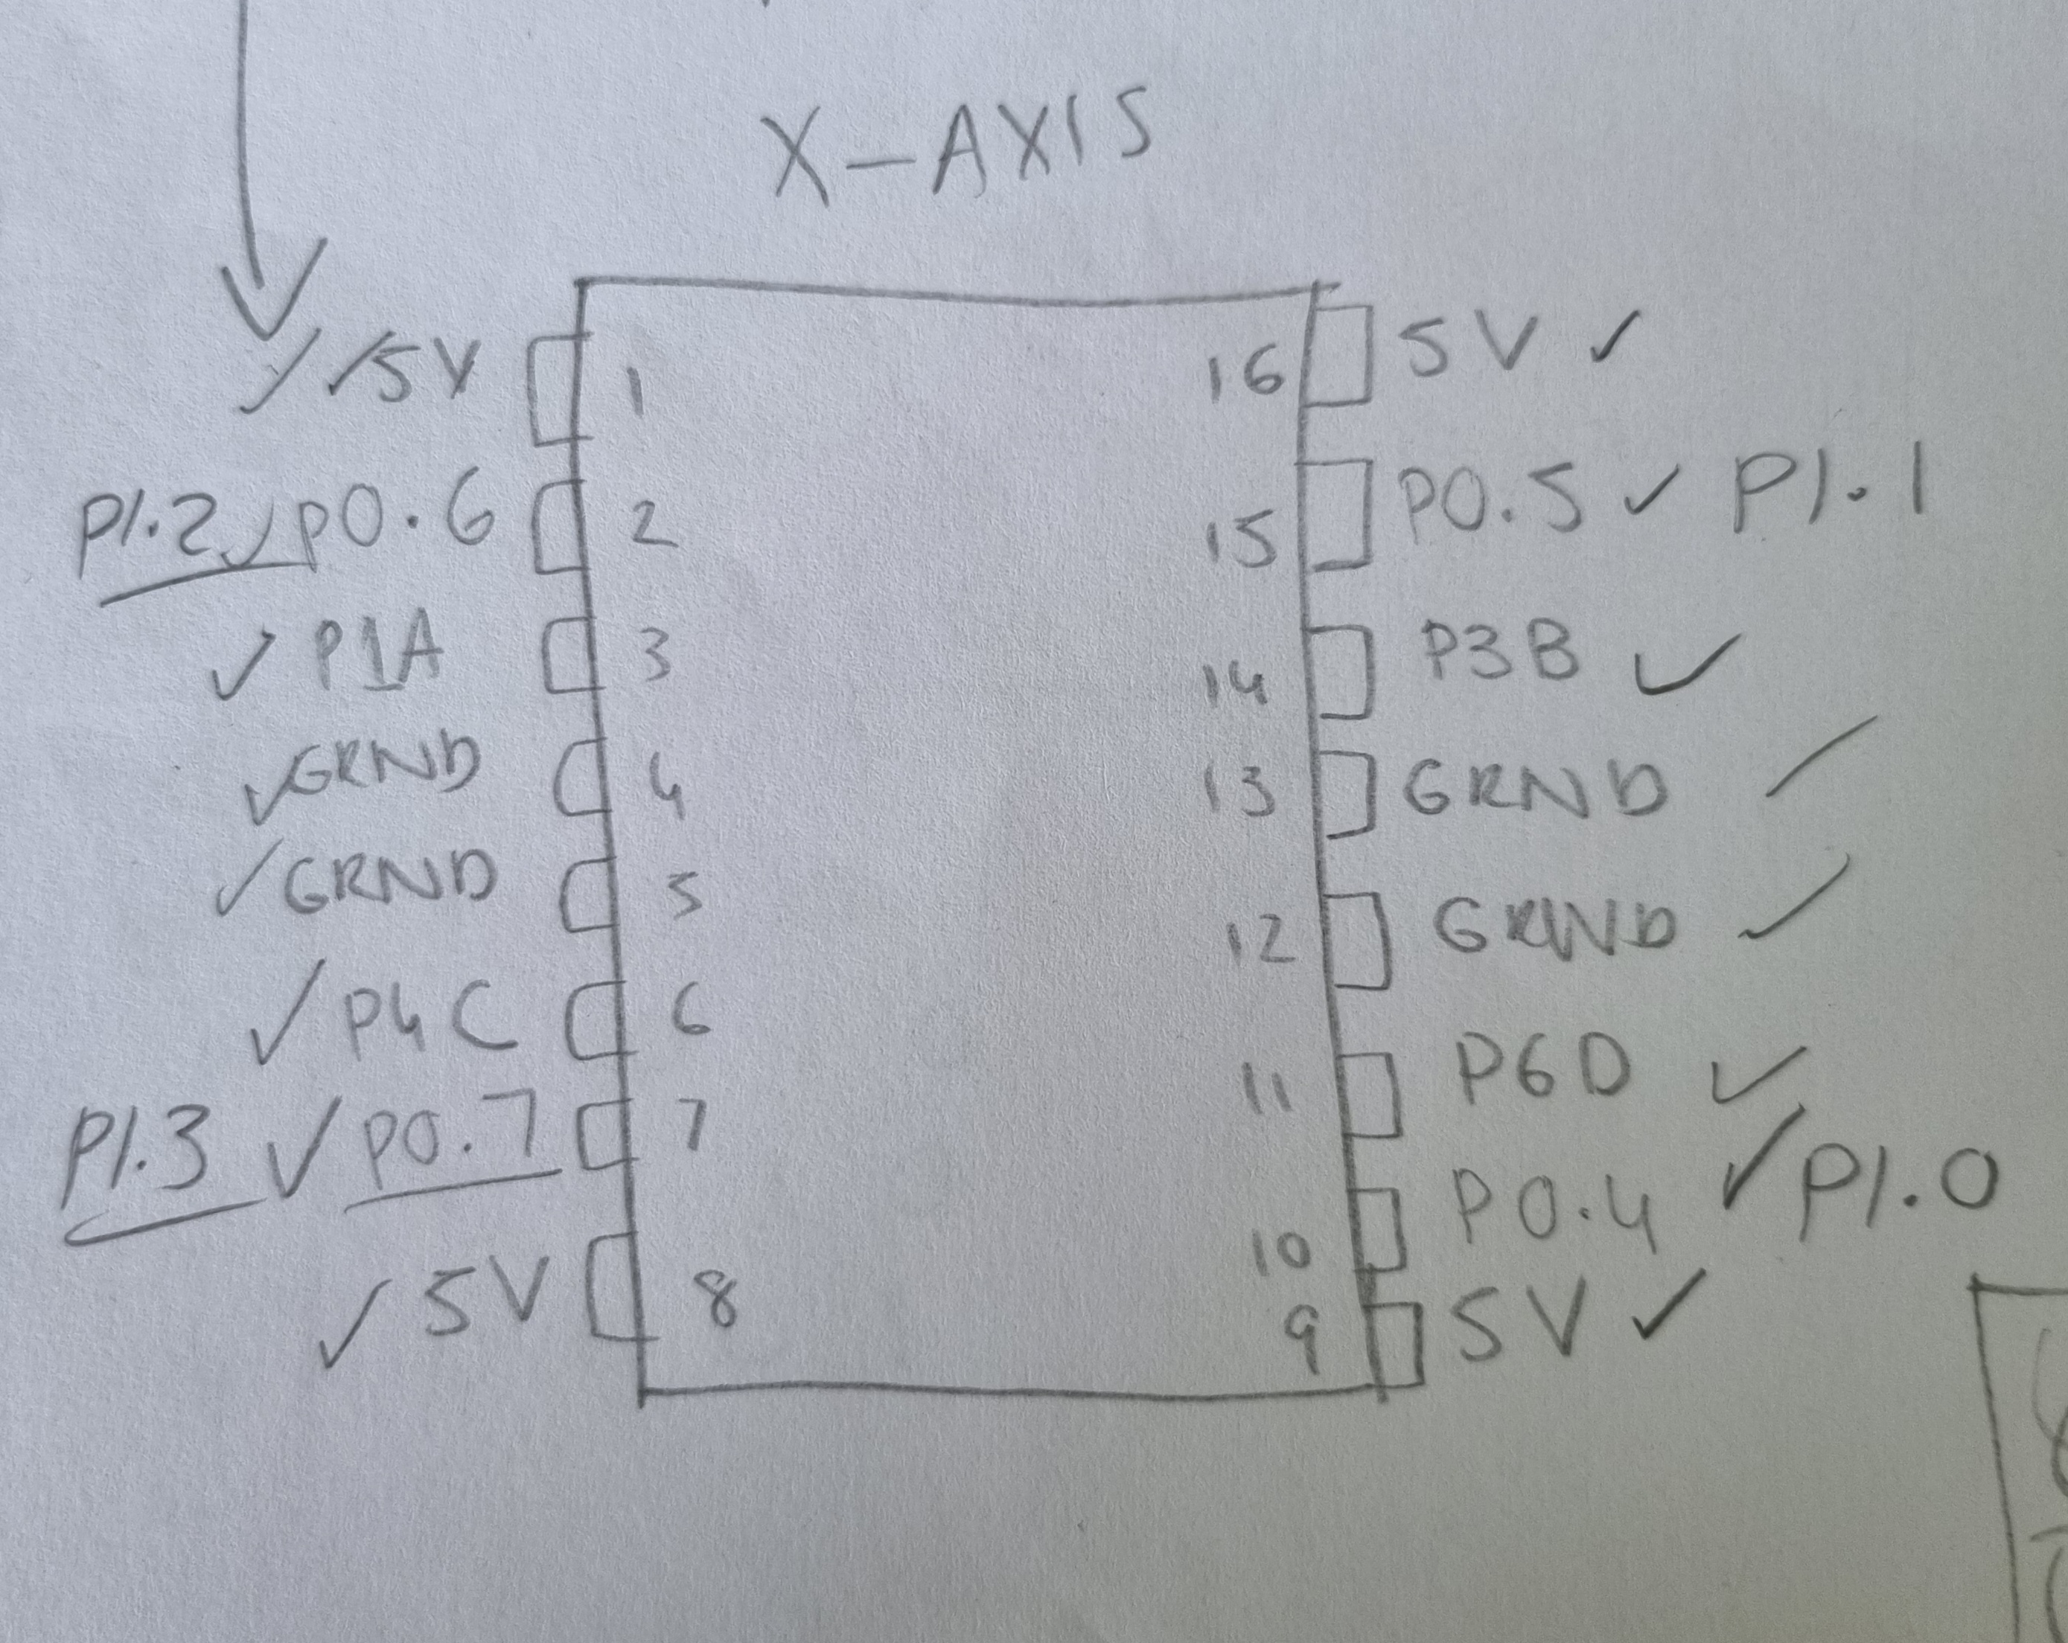
L293D-Driver Chip

Slide 27
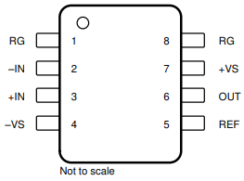
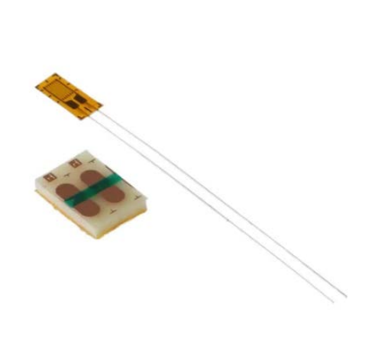
Extra Specifications
- INA122P
G = 5-10,000V/V $.^{[5]}$
CMRR $≈$ 96dB
Instrumentation Amplifier
- RS PRO Wire Lead SG
120 $Ω.^{[6]}$
2.5 / 5mm
Strain Gauges

Slide 28
LabVIEW Code

